Slide 1
Staying Safe Online
A practical guide to digital privacy for everyday activists

Slide 2


Slide 3

Go low-tech!

Slide 4
What We’ll Cover Today
1
2
3
4
Threat
Modeling
Evaluating Software
& Services
Passwords
& Accounts
Two-Step Login
5
6
7
8
Private Messaging
& Calls
Sharing Files
& Documents
Browsers &
Search Engines
VPNs &
Blockers
9
10
11
12
Data Brokers
& Removal
Phones: Burners & Alts
AI Tools
& Privacy
De-Googling

Slide 5


What Is Encryption, Really?
The joke:
The priest prays in "New Latin" — which is just pig latin. Everyone can hear the words. Only someone who knows the rule can understand them.
Real encryption works the same way:
Your message gets scrambled by a mathematical rule so complex no computer can crack it. Anyone who intercepts it just sees gibberish. Only your recipient's app has the key to unscramble it.
Robin Hood: Men in Tights (1993)
The scrambled message travels through the internet in plain sight — the encryption is what makes it unreadable to everyone except the recipient.

Slide 6


Not All Encryption Is Equal
Client-Server Encryption (e.g. many messaging apps) — wire is encrypted, but the server decrypts and can read your messages
Hello!
Hello!
Xj3#mL9...
SERVER
Xj3#mL9...
⚠ Sees your message:
Hello!
Alice
Bob
End-to-End Encryption (E2EE) (Signal, iMessage) — ciphertext the entire way; even the server only sees scrambled data
Hello!
Hello!
Xj3#mL9...
SERVER
Xj3#mL9...
✔ Cannot read — only sees:
Alice
Xj3#mL9...
Bob
With E2EE, even the app company's own servers cannot read your messages — only you and your recipient can.

Slide 7



Slide 8


MODULE 1 OF 12
Threat Modeling
Who is out to get us?

Slide 9
Threat Modeling
Adversaries
Governments (foreign & domestic)
Surveillance Capitalism
  Advertisers
  Data Brokers
Criminals
  Credit card theft, ransomware
Corporate Espionage
Abusers, Stalkers

Slide 10
Threat Modeling
Types of Data
Basic personal info: Name, age, gender, etc.
Demographic & Financial
Online Activity & Interests
Health & Buying Habits
Public & Legal Records

Slide 11

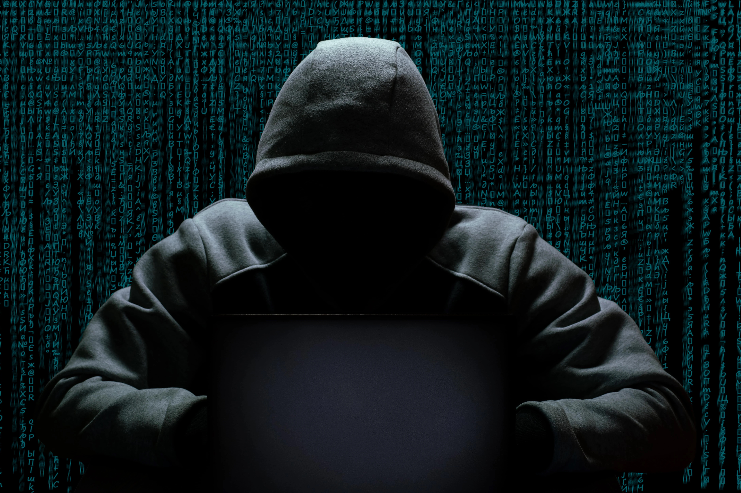
Threat Modeling
Types of Threats
Dragnets
Automated, passive, inexpensive
Data Collection & Tracking
Mass Surveillance
Network Traffic
Malware - low-complexity
Targeted
Personalized, expensive
Malware - high-complexity
Hardware tampering
Stingrays (fake cell towers)
Impersonation, Spear Phishing
But all my information is already out there, what does it matter?
Notes:
Dragnets - Automated, passive
These are threats that affect large groups of people automatically, without anyone specifically targeting you.
Data Collection & Tracking — Companies like Google, Facebook, and your phone's manufacturer collect information about what you do online and on your device. They track which websites you visit, what you search for, and what you buy. This data is valuable and gets sold to advertisers.
Mass Surveillance — Governments and law enforcement use cameras, license plate readers, and phone tracking to monitor public spaces and movements. Your phone company also knows where your phone is at all times based on which cell towers it connects to.
Network Traffic — When you use WiFi or mobile data, the companies providing that connection can see what you're doing online (unless it's encrypted). Public WiFi especially is risky because anyone on that network could potentially see your activity.
Malware (broadly applied) — Bad actors create viruses and malicious software that spreads to many devices at once, stealing passwords, financial information, or personal data.
This data often gets sold and combined with information from other sources to build detailed profiles about you.
Targeted - Personalized, expensive
These are threats aimed at a specific person. They require more resources and effort, so they're typically used by governments, large criminal organizations, or well-funded adversaries.
Malware - high-complexity vulnerabilities — Attackers find sophisticated weaknesses in software that most people don't know about, then create custom malware to exploit those weaknesses on that person's device. This malware can secretly access their messages, location, camera, or microphone.
Hardware tampering — If someone has physical access to your device, they can install tracking devices or modify the hardware itself to spy on you.
Stingrays (fake cell towers) — Law enforcement and some governments use devices that trick your phone into connecting to a fake cell tower. Once connected, they can see your location, intercept your calls and texts, or force your phone to reveal information.
Impersonation, Spear Phishing — Attackers research a specific person and create convincing fake messages or communications pretending to be someone they trust—a colleague, friend, or organization. The goal is to trick them into revealing passwords or downloading malware.

Slide 12
Threat Modeling
Methods
Social Engineering
Device Compromise
Credential Theft
Radio Interception
Device Theft

Slide 13
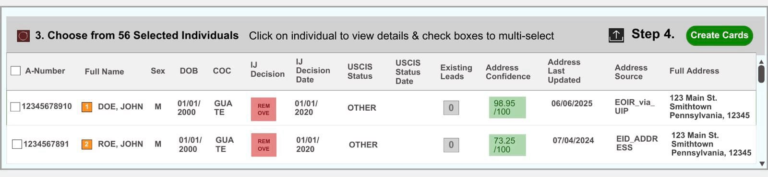
Threat Modeling
Elite App
Notes:
Dragnets - Automated, passive
These are threats that affect large groups of people automatically, without anyone specifically targeting you.
Data Collection & Tracking — Companies like Google, Facebook, and your phone's manufacturer collect information about what you do online and on your device. They track which websites you visit, what you search for, and what you buy. This data is valuable and gets sold to advertisers.
Mass Surveillance — Governments and law enforcement use cameras, license plate readers, and phone tracking to monitor public spaces and movements. Your phone company also knows where your phone is at all times based on which cell towers it connects to.
Network Traffic — When you use WiFi or mobile data, the companies providing that connection can see what you're doing online (unless it's encrypted). Public WiFi especially is risky because anyone on that network could potentially see your activity.
Malware (broadly applied) — Bad actors create viruses and malicious software that spreads to many devices at once, stealing passwords, financial information, or personal data.
This data often gets sold and combined with information from other sources to build detailed profiles about you.
Targeted - Personalized, expensive
These are threats aimed at a specific person. They require more resources and effort, so they're typically used by governments, large criminal organizations, or well-funded adversaries.
Malware - high-complexity vulnerabilities — Attackers find sophisticated weaknesses in software that most people don't know about, then create custom malware to exploit those weaknesses on that person's device. This malware can secretly access their messages, location, camera, or microphone.
Hardware tampering — If someone has physical access to your device, they can install tracking devices or modify the hardware itself to spy on you.
Stingrays (fake cell towers) — Law enforcement and some governments use devices that trick your phone into connecting to a fake cell tower. Once connected, they can see your location, intercept your calls and texts, or force your phone to reveal information.
Impersonation, Spear Phishing — Attackers research a specific person and create convincing fake messages or communications pretending to be someone they trust—a colleague, friend, or organization. The goal is to trick them into revealing passwords or downloading malware.

Slide 14
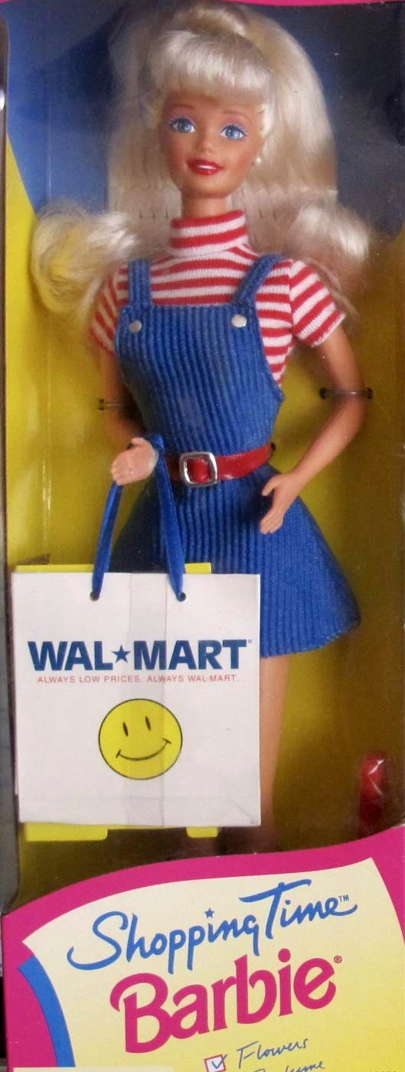
MODULE 2 OF 12 · A 5-Question Heuristic
Evaluating Software
and Services

Slide 15
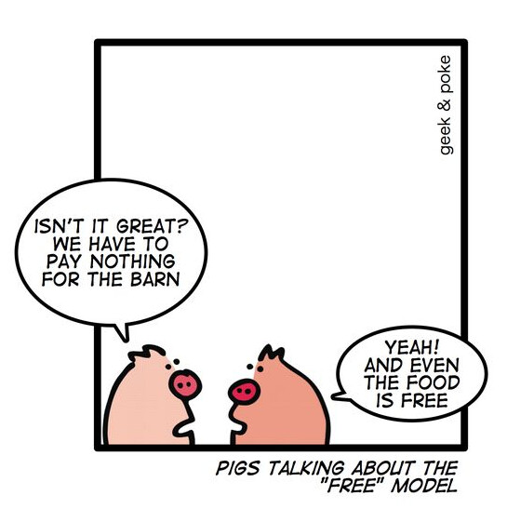

Slide 16
5 Questions to Ask Before Using Any Service
These questions take about 5 minutes and require no technical knowledge — just a search engine.
1
Where is it based?
Jurisdiction matters more than promises.
2
How does it make money?
If it's free, are you the product?
3
Has it been independently audited? Are they open source?
Anyone can claim good security.
4
What do they do with government requests?
Look for a transparency report.
Personal trust factors: Have they broken trust before? Do they feed everything to AI?
Not everyone has the same concerns, what matters to you?
5

Slide 17
Question 1: Where Is It Based?
Companies must follow the laws of the country where they're headquartered.
Search: "[service name] headquarters country"
⚠ Red flag countries
✅ Stronger privacy countries
USA, UK, Canada, Australia, New Zealand
Switzerland, Iceland, Germany, EU members with strong data laws
These share intelligence with each other (the "Five Eyes"). US law enforcement can issue secret orders compelling companies to hand over data and stay silent.
Harder for foreign governments to compel disclosure. Companies can often legally refuse or challenge requests.

Slide 18
Worked Example: Box.com vs. Proton Drive
Question
Box.com
Proton Drive
Where is it based?
USA — subject to US law & secret orders
Switzerland — strong legal privacy protections
Business model?
Enterprise subscriptions
Paid subscriptions — you are the customer
Independently audited?
Standard IT compliance audits
Regular third-party security audits, results published
Government requests?
Complies with US requests; no warrant canary
Publishes transparency reports; legally challenges overreach
Open source?
Proprietary / closed source
Client apps open source on GitHub
✔ Proton Drive is the better choice for sensitive activist documents.

Slide 19
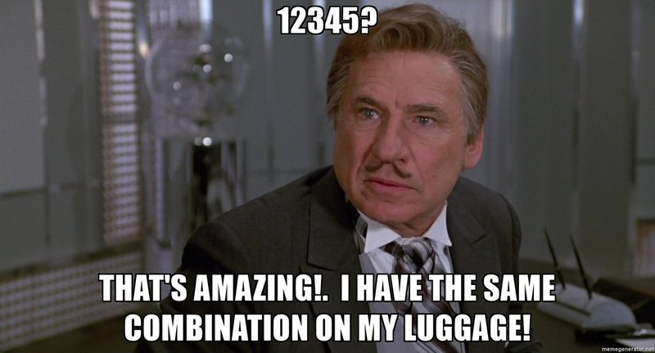
MODULE 3 OF 12
Passwords & Accounts

Slide 20
The Problem with Passwords
Most people reuse the same password everywhere.
When one website gets hacked — and this happens constantly — attackers automatically try that same password on your email, your bank, and your social media.
A strong password must be:
Long - The longer the better
Random including numbers, upper and lowercase letters and symbols — not your name, birthday, or pet's name
Unique — never reused on any other site

Slide 21
The Solution: A Password Manager
A password manager remembers all your passwords for you, locked behind ONE master password — or your fingerprint.
1Password
Bitwarden
KeePassXC
~$3/month
FREE · OPEN SOURCE
FREE · ON-DEVICE ONLY
Excellent design. Third-party audited. Works on phone and computer. Widely trusted by security professionals.
Free and open source. Works on phone and computer. Quality implementation. US-based company.
Stores passwords only on your device — never in the cloud. No company to subpoena. Harder to set up.
Diversify! If one resource is compromised, don't let them get everything!

Slide 22
Usernames, too!
Email Aliases:
Proton Mail
SimpleLogin
Unique address for every sign-up. Bonus - If you get spam, you know who sold you out!
Phone number Aliases:
Burner (app)
MySudo
Hushed
Tossable Digits
Text Now
Google Voice

Slide 23

MODULE 4 OF 12 · Also called: Two-Factor Authentication (2FA)
Two-Step Login

Slide 24
What Is Two-Step Login?
Even a stolen password can't get someone in if they don't have your second step.
🔑 Think of it as a door with two locks. Even if someone copies your key (password), they still can't get in without the second lock.
Turn it on for these first:
Your primary email account
Bank and financial accounts
Social Media Accounts

Slide 25
Which App Generates Your Codes?
Text message codes? No! These apps generate the 6-digit codes for two-step login.
Aegis
(Android)
Raivo (iPhone)
Proton
Authenticator
ProtonPass
or 1Password
(built-in)
Duo
DEDICATED · RECOMMENDED
DEDICATED · GOOD CHOICE
CONVENIENT · WITH CAVEAT
WORKPLACE / SCHOOL
Open source. Encrypted. Stores codes only on your device unless you choose otherwise.
Swiss-based. End-to-end encrypted sync. Separate from ProtonPass. Newer but solid.
Has TOTP built in — fine for most accounts. But NEVER use to protect the password manager itself.
Enterprise app from Cisco (US). You may be required to use it. Not really a consumer choice.
⚠ Avoid Authy: 33 million phone numbers were exposed in a 2024 breach, enabling targeted phishing attacks.

Slide 26

MODULE 5 OF 12
Private Messaging & Calls

Slide 27
Use Encrypted Messaging
What is encryption?
Encryption scrambles your message so only the recipient can read it — not your phone company, not the app company, not hackers listening in.
NOT Encrypted
Encrypted ✓
Regular SMS / text messages
Standard email (Gmail, Yahoo, etc.)
Facebook Messenger (by default)
Signal (free — the gold standard)
iMessage (blue bubbles on iPhone)
WhatsApp (has encryption -- probably?)
Try it: Download Signal (free) and ask a friend or family member to download it too — then message each other there.

Slide 28
Who Can Read Your Messages?
Regular SMS / iMessage (non-blue) / Facebook
Signal
Copies stored on company servers
End-to-end encrypted by default
Company can read your messages
Not even Signal can read your messages
Government can request access
Nothing useful to hand over to government
VS
If hacked, messages can leak
Messages can disappear automatically

Slide 29
Use Signal
Use Protonmail
Or:
Matrix/Element - Iffy server-side trust
Session - Iffy cryptography
SimpleX - UK jurisdiction, young project
Or:
Tuta -- Fewer other services
Mailfence -- Fewer other services

Slide 30
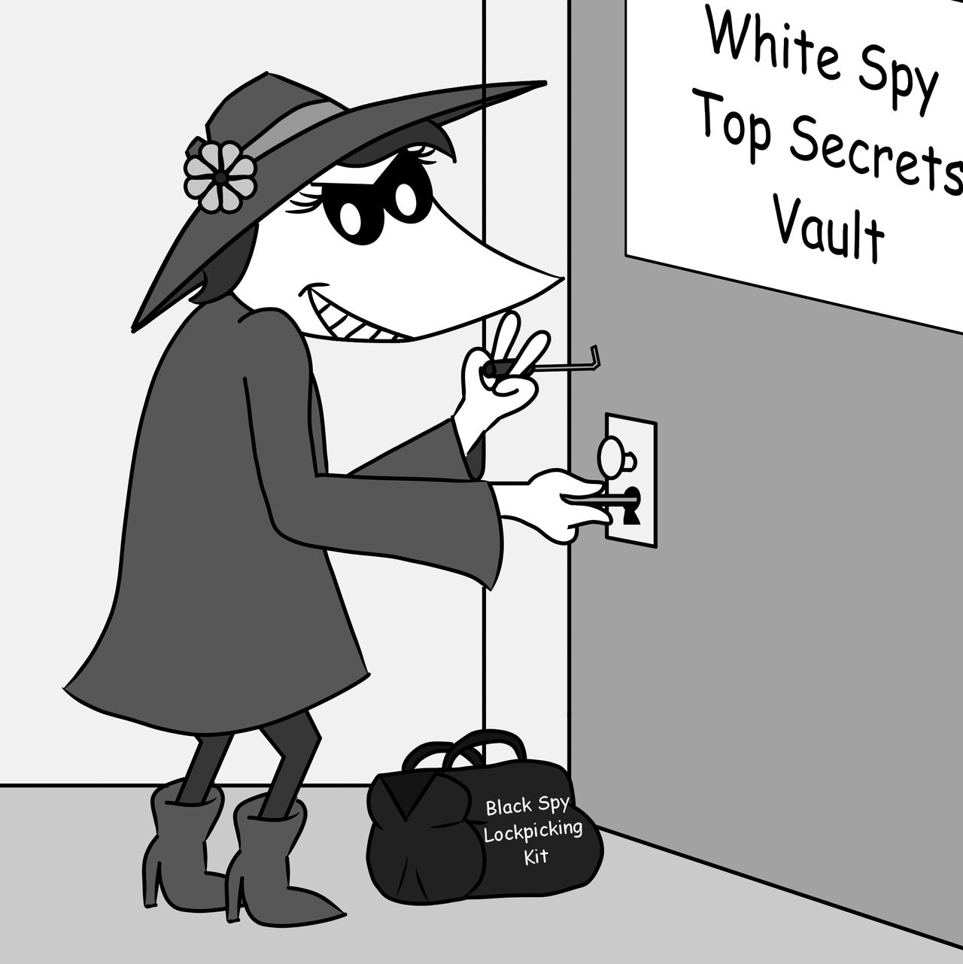
MODULE 6 OF 12
Sharing Files & Documents

Slide 31
How to Share Files Safely
Email attachments and Google Drive links are stored on US servers and can be accessed by the company or handed to law enforcement.
💡 If you wouldn't want it on the front page of a newspaper, don't store it in an unprotected service.
Proton Drive
Filen
Signal
Best for: sending a file directly to one person
Best for: storing and sharing sensitive documents
Honorable mention for: storing and sharing sensitive documents
The same app you use for messages. Files are end-to-end encrypted. Free.
End-to-end encrypted cloud storage. Based in Switzerland. Free 1GB tier.
End-to-end encrypted cloud storage. Based in Germany. Free 10GB tier.

Slide 32

MODULE 7 OF 12
Browsers & Search Engines

Slide 33
Which Browser Should I Use?
Your browser sees everything you do online. Who made it — and what they do with that information — matters.
Chrome
Safari
Firefox
Brave
AVOID
BETTER THAN CHROME
GOOD CHOICE AFTER CONFIGURATION
RECOMMENDED
Made by Google, whose core business is advertising. Tracks your browsing habits. Since 2025, uses digital fingerprinting to follow you even without cookies.
Apple's browser. Blocks cross-site tracking by default. Closed source — you can't verify its privacy claims. US-based. A decent default for iPhone/Mac users.
Blocks ads and trackers by default. Open source. Built on the same engine as Chrome, so all your sites work. Top pick among privacy experts. Has optional crypto features — easy to ignore.
Open source, non-profit (Mozilla). Stronger privacy than Chrome with some setup. Works on all devices. Well-trusted by the security community.
🔒 Firefox derivatives like LibreWolf, Waterfox, etc — for maximum privacy: strips all tracking from Firefox, fully open source community project. Some sites may behave differently.

Slide 34

Trust but verify
https://coveryourtracks.eff.org/
https://amiunique.org/fingerprint

Slide 35
Which Search Engine Should I Use?
Google logs every search you run and links it to your identity. Switching takes about 30 seconds.
Google / Bing
DuckDuckGo
Brave Search
Kagi
AVOID
BETTER THAN GOOGLE
RECOMMENDED
Also Good
Profile every search you run and link it to your identity. Core business is advertising. US-based. Bing is Microsoft's equivalent — same concerns.
Doesn't log your IP or build a search profile. US-based. Until 2023, a contract with Microsoft allowed Bing trackers through — that loophole has since been closed.
Independent search index — not just repackaged Google or Bing results. No tracking, no profiling. The default search engine in Brave browser.
Paid, so you're the customer. Quality search results
💡 To change your default search engine in any browser: Settings → Search Engine → choose Brave Search or DuckDuckGo. If you switch to Brave browser, it's already set.

Slide 36

MODULE 8 OF 12
VPNs and Blockers

Slide 37
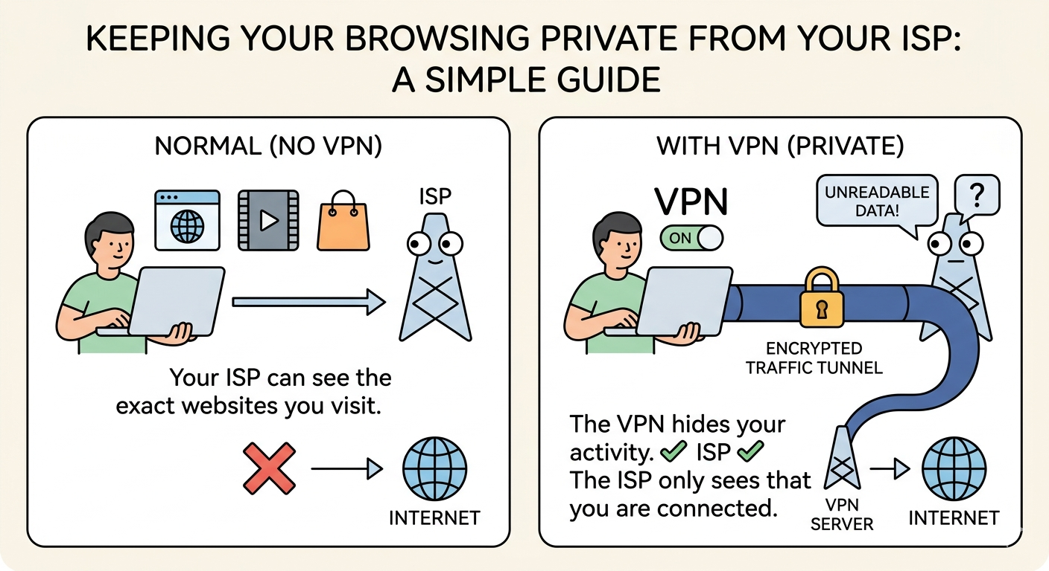
VPNs & Blockers

Slide 38
VPNs & Blockers
Shop Carefully
VPNs
Proton - Includes tracking & ad protection
  Has free tier
Mullvad - Includes tracking & ad protection
Ad & Tracker Blockers
Windows, MacOS, iPhone/iPad:
  NextDNS
  Trustworthy Browser (Brave) or uBlock Origin browser extension
  VPN
Android:
  DuckDuckGo App Tracking Protection
  Anything from above

Slide 39
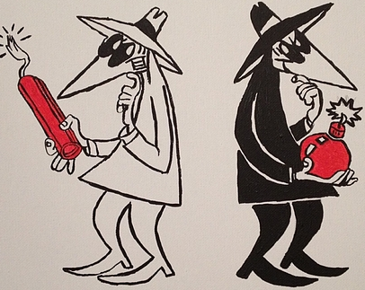
MODULE 9 OF 12
Data Brokers and Removal

Slide 40
Data Brokers & Removal
Data Brokers collect and buy information about you:
Information you type into a website
Metadata bought from your ISP, surveillance cameras, etc
Voter Rolls, Warranty cards, loyalty programs
They sell it to:
Advertisers
Insurance Companies
Credit Score Companies
Retailers for "Personalized Pricing"
Political Campaigns or Parties
Government (ICE, FBI have both admitted they buy)

Slide 41
Data Brokers & Removal
You can:
Try to prevent information about you from going out in the first place
  Use encryption whenever possible
  Use VPNs, Tracker-Blockers & Ad-Blockers
  Be mindful of what you post on social media
Disable unused permissions on your phone, uninstall unused apps
Delete what you control
Request deletion from parties that offer it
  Paid services like DeleteMe and Incogni can do a lot of this for you

Slide 42
  MODULE 10 OF 12
De-Googling
Instead of | Try
Google Search | Brave, DuckDuckGo, Kagi, etc
Gmail | Proton, Tuta, Mailfence
Chrome | Brave Browser, DuckDuckGo, Firefox
Google Maps | OSMAnd, Magic Earth
Google Docs & Drive | Proton
Android Phones | GrapheneOS

Slide 43
MODULE 11 OF 12
Phones: Burners & Alts

Slide 44
Burner Phones
Anonymous, not tied to your identity
Very hard to arrange:
  Pre-paid phone, pay cash
  Do not bring your regular phone when you buy it
  Do not drive your own car, avoid license plate scanners
  Wear hat, sunglasses, mask to (maybe?) avoid facial recognition cameras
  Do not turn it on at your home, do not have it on and moving in step with your regular phone
  Do not log into any of your accounts with it
  Throw it away early and often, cut the SIM card into small pieces with scissors
🔒 Examples of pre-paid wireless carriers: Simple Mobile, Tracfone, Straight Talk, Total Wireless. Buy from big-box stores like Target or Wal-Mart

Slide 45
Alt-Phones
NOT anonymous, tied to your identity
Easier to arrange, can use an old phone with a new, pre-paid SIM
Maybe you don't even need a SIM if you're willing to just use WiFi
Still helpful. If confiscated:
  Does not have your full chat history with everyone
  Does not have your full contacts list
  Is not signed into all your accounts, does not grant access to your entire online ecosystem

Slide 46
Faraday Bags or Pouches
Block all radio signals
Does NOT block sounds - If there is malware on your phone, it may still record sound to be sent later
Does not block signals within the bag -- Two phones in the same bag can communicate with each other
  Phones are likely noting what nearby phones they can "see" to track who you know
Not all bags are created equal. Shop carefully and test:
  Place a phone in a bag, call it with another phone

Slide 47
MODULE 12 OF 12
AI Tools & Privacy

Slide 48
What Your AI Assistant Stores
ChatGPT, Gemini, Copilot, Claude — every major AI chatbot is a US-based company. The same 5-question check applies, and the answers are concerning.
🗄️
👁️
⚖️
Stored on US servers
Can be reviewed by staff
Can be subpoenaed
Conversations are kept indefinitely by default. Subject to US law, secret court orders, and Five Eyes intelligence sharing.
Employees may read your transcripts for safety reviews or model training — unless you opt out in settings.
OpenAI received requests for 26 chat logs in the first half of 2025 alone. Courts have used AI chat history as criminal evidence.
Unlike a conversation with a lawyer, nothing you tell an AI chatbot is legally privileged.

Slide 49
Using AI More Safely
Ask yourself: would I be comfortable if this prompt became part of a courtroom proceeding?
❌ Keep out of cloud AI
⚠ OK for non-sensitive tasks
✅ For sensitive work: local AI
Names, locations, or dates tied to organizing
Turn off chat history first (Settings → Data Controls)
Runs on a private server — nothing sent to any company
Legal-adjacent plans or anything you wouldn't say in public
Opt out of model training in settings
No conversation history stored anywhere
Sensitive information about other people
Fine for general research, writing help, editing
No company to subpoena
Ask me after class — I'm exploring offering this as a resource

Slide 50
BONUS MODULE: PSYCHOLOGICAL SAFETY
Psychological Safety
What the research shows about protecting your mind online

Slide 51
The Platform Is the Problem
These platforms are not neutral pipes. They are engineered systems optimized to keep you engaged — and the techniques they use have measurable effects on your emotional state.
1
Observe and profile you
Every interaction trains a model of your psychology
2
Maximize your time on platform
Engagement is the product sold to advertisers
3
Weight content that provokes reactions
Outrage drives more clicks than calm
4
Refine the model continuously
The algorithm knows your vulnerabilities before you do
5
Sell access to your attention
You are not the customer -- you are the inventory

Slide 52
Two Things That Actually Help
The most consistently supported interventions in the research literature.
Spend Less Time in the Feed
Make It Harder to Get In
REDUCE TIME ON PLATFORM
ADD FRICTION
Multiple randomized controlled trials show significant reductions in depression, anxiety, and fear of missing out when social media use is limited. A 30-minute daily limit produced a 35%+ improvement in depression scores in one study. Even one week off produced measurable gains.
Move apps off your home screen. Turn off push notifications. Switch your phone to grayscale. These small barriers shift usage from habitual and reactive to intentional. Research shows a 50% reduction in use, enforced by screen time apps, significantly improved emotional well-being.
Sources: randomized controlled trials in Cyberpsychology, Behavior & Social Networking; Journal of Medical Internet Research; U.S. Surgeon General's 2023 advisory on youth mental health.

Slide 53
Two More Evidence-Based Strategies
Less consistent than reducing time, but worth understanding.
Switch to Chronological Feed
Learn to Recognize Manipulation
MIXED EVIDENCE
STRONG EVIDENCE
A large field experiment found chronological feeds reduced time on platform and disrupted the engagement loop. However, the same study found more exposure to untrustworthy sources. Effects on attitudes were modest over three months. Still worth trying -- just not a clean fix.
"Prebunking" -- exposure to examples of manipulation techniques before you encounter them -- significantly improved recognition in 30,000-participant studies. A 19-second Instagram ad made users 21 points better at spotting emotional manipulation. Try getbadnews.com.
Sources: Bail et al., Science (2018); Aslett et al., Nature (2024); Lewandowsky et al., Science Advances (2022); Instagram field study, Harvard Misinformation Review.

Slide 54
If it made you furious, ask why.
Platforms profit when you react.
Strong emotional reactions -- especially outrage -- are often the intended effect of algorithmic design, not spontaneous responses to the facts.
When content provokes an intense reaction, treat that as a signal to pause. That pause is where the manipulation either succeeds or fails.

Slide 55
Your One Thing
What is the ONE thing you're going to do this week?
Set up Bitwarden (password manager)
Turn on two-step login for my email
Download Signal and message one person with it
Move one sensitive document off Google Drive into Proton Drive

Slide 56
Where to Learn More
privacyguides.org
Well-maintained, non-commercial guide to privacy tools. Use the "Tools" section to compare services.
ssd.eff.org
EFF Surveillance Self-Defense. Guides organized by threat level — from basic to high-risk activist.
activistchecklist.org
Practical security checklists specifically designed for organizers and activists.
signal.org
Download Signal. The most important single step most people can take.

